Slide 1
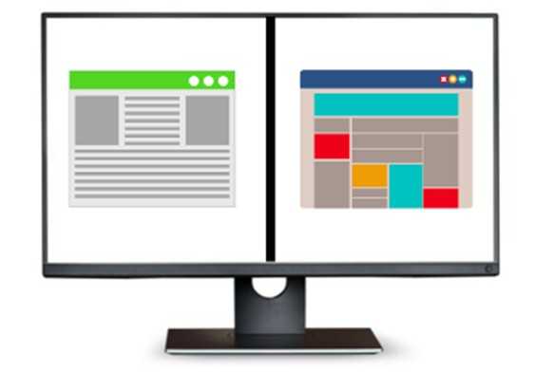
Split screen and working with multiple documents simultaneously
What does this mean? Divide screen into 2 or more sec-
tions. Working with multiple tabs and other document
forms.
Does this promote shallow or deep learning?
What are the advantages?
What are the challenges?
Learning Development at Lancaster University

Slide 2
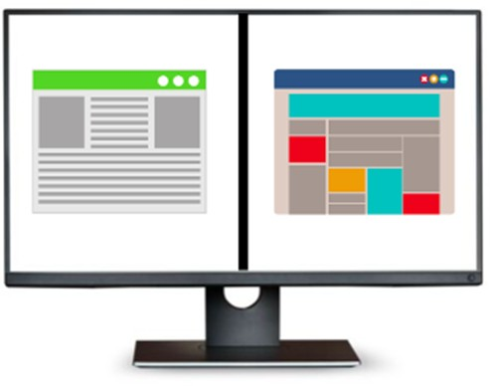
Split screen and working with multiple documents
simultaneously
Does this promote shallow or deep learning? So long as you are actively engaging with the process, deep
learning. However, some students may be distracted by multiple readings at once, which may produce a shal- lowing effect.
Advantages Challenges
You can easily move between different documents.
Managing broken hyperlinks/expired log-ins can be frustrating.
More sources can empower you to make persuasive arguments in your writing.
You may find it difficult to engage with and navigate
busy, crowded screens.
You can create tailored word documents to support assignments, and look at this while you are reading.
You may take notes in different formats, i.e. on PDF and word. This could cause confusion at a later date.
Some students find digital storage processes easier
than managing multiple hard copies of texts and notes.
You may find it difficult to gauge when reading is ‘enough’ and to track progress with multiple sources open at once.

