Slide 1
Level 6: What are your assessors looking for (Academic Practice)?
Systematic understanding of key aspects…coherent and detailed knowledge, at least some of which is at the forefront…of the discipline
Ability to deploy established techniques of analysis and enquiry within the discipline
Devise and sustain arguments and/or solve problems, some of which are at the forefront of the discipline.
Communicate information, ideas, problems and solutions to both specialist and non-specialist audiences
Critically evaluate arguments…and data…to make judgements and frame questions to achieve a solution – or range of solutions – to a problem.
Adapted from: Quality Assurance Agency (2014)
Adapted from: Quality Assurance Agency (2014)
Notes:
Run through simplified QAA L6 benchmarks – key words: knowledge, analysis, problem-solving, communication, critical evaluation. Emphasise that these things are inextricably linked – you can’t critically evaluate what you don’t know well enough – and that this concept will be explored in a deceptively simple exercise later in the session. You could also include any marking rubrics or specific assessment criteria in this discussion.

Slide 2
Critical thinking in clinical practice
Thinking about the academic criteria in the previous slide…
Knowledge
Analysis
Problem-solving
Communication
Critical evaluation
How do you think that these underpin safe and effective nursing practice?
“A competent nurse is one who selects the relevant information to plan a course of action and then judges what is best to do in a given circumstance (Price and Harrington, 2016, p3.)
Notes:
Prompt slide for facilitated discussion – can be used to assess existing knowledge and competence, and also to begin to ‘join the dots’ between academic and professional criteria. Ideally facilitated with a subject specialist if possible.
As we will see later in the session, critical thinking is not just a mental/cognitive process. It involves decision making, which may include analysing and choosing a particular course of action from a range of options. Can you think of any examples form your own placements where you have either seen this process in action, or perhaps even dome this yourself?

Slide 3
Level 6: What are your assessors looking for (Professional Practice)?
Part 3: Practising independently with minimal supervision and leading and co-ordinating care and confidence
'Achieved' must be obtained in all three criteria by the student.
Achieved | Knowledge | Skills | Attitude and Values
Yes | Has a comprehensive knowledge base to support safe and effective practice and can critically justify decisions and actions using an appropriate evidence base | Is able to safely, confidently and competently manage person-centred care in both predictable and less well recognised situations, demonstrating appropriate evidence based skills. | Acts as an accountable practitioner in responding proactively and flexibly to a range of situations. Takes responsibility for own learning and the learning of others.
No | Is only able to identify the essential knowledge-base with poor understanding or rationale for care. Is unable to justify decisions made leading to unsafe practice. | With minimal supervision is not able to demonstrate safe practice despite guidance. | Demonstrate lack of self-awareness and professionalism. Does not take responsibility for their own learning and the learning of others.
Practice Assessment Document (PAD): Person-Centred Care 3
Notes:
FOR NURSING STUDENTS ONLY – check their MYEPAD and edit accordingly!
This is an extract from the Level 6 Practice Assessment Document (PAD) that nursing students use to record their skills and achievements in clinical practice placements. The bold emphasis is mine, to highlight the links between academic and professional attributes and how a critical approach supports both. When I do this session, I try, where possible, to involve a nursing lecturer who can give real examples/scenarios of how a registered nurse needs to be able to make decisions and scenarios in which they may be called on to justify them (e.g. after a death, drug error, near miss, never event etc…)
“At this point, I think it would be good to spend a few minutes thinking about why academic skills are so important for a nursing degree. Why do we care that you’ve used citation and referencing properly, and that you’ve got your information from textbooks, journal articles and the websites of established, credible organisations rather than the first website that Google recommended. At this point, I’m going to hand over to my colleagues ---- to say a little more about this in the next three slides before we move on to unpack the term ‘criticality’ as it relates to professional practice in more detail.”

Slide 4
What is Critical Thinking?
Notes:
Facilitated discussion. What do students currently understand by the term ‘critical analysis’ or ‘critical thinking’?
When we looked at the indicators for success at L6, you’ll have noticed that the word ‘critical analysis’ featured prominently. You’ll hear phrases like critical analysis, critical evaluation and critical thinking and writing used a lot more frequently this year – but what does this word mean?
After discussion:
At university, criticality refers to a specific way of thinking about knowledge and information, and of using it in your work. It means that you need to be able to compare different sources of information, to question and to challenge them, to establish links, similarities and differences, and to begin to apply the information in different situations. The umbrella term for these skills and processes is criticality.
The word critical, when used in an academic context doesn’t have the same meaning as it does in everyday life, where it’s associated with negativity, pickiness or fault finding. It’s about taking a sceptical, balanced and considered approach to your learning. At Level 6, you should no longer be uncritically consuming and accepting what you see, read or hear – you need to STOP, THINK and ASK QUESTIONS!

Slide 5
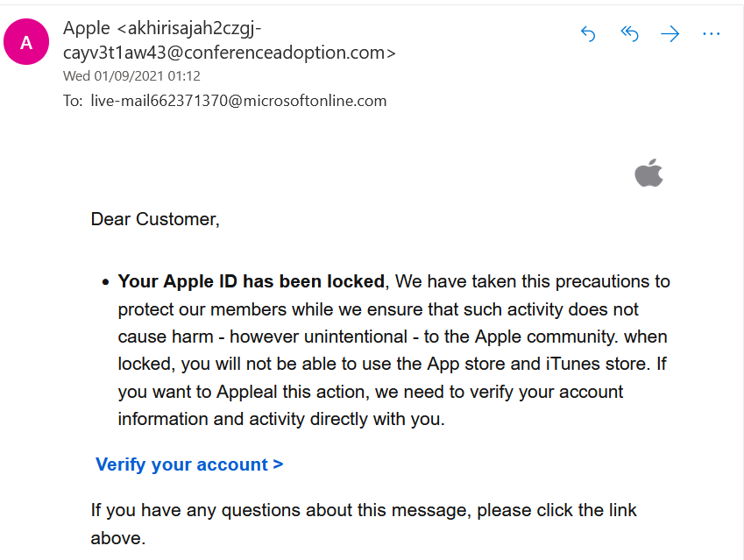
Everyday Critical Thinking
Notes:
Critical thinking is frequently described as a higher order academic skill and it can sometimes develop after other academic skills e.g. citation and referencing, are well established. However, most of us actually engage in critical thinking every day without even being aware that this is what we’re doing. Let’s have a look at an email I received the other day, claiming that my Apple ID has been disabled and that I should click on the link kindly provided in the email to fix this problem. If you were in my position would you a) believe that your Apple account had been disabled and b) would you click the link to try to fix it? (GIVE TIME TO LOOK AT THE EMAIL PROPERLY). Also, see if you can jot down some specific reasons for your answer. Why would you make that decision? How would you justify it?
CAN BE USED WITH POLLING SOFTWARE e.g. survey for Yes/No and then text responses for reasons and justifications.
For smaller groups, a facilitated discussion provides the opportunity to use questioning to draw out some of the reasoning processes that students were not consciously aware of – “Yes, but how do you know that…?”
Well, hopefully, the answer to both of these questions would be NO.
But the more interesting and more critical question here is WHY? What is it about this message that makes you doubt – or feel sceptical about - its trustworthiness? What is it that stops you from uncritically accepting what it says, clicking the link and giving them whatever information they ask? In polleverywhere, type in a feature of the message that makes you feel sceptical or doubtful that it really came from Apple and that it wouldn’t be wise to click that link. If you’ve got time, you can offer more than one suggestion.

Slide 6
Everyday Critical Thinking
As well as the obvious surface level features, what else might have made you suspicious or sceptical here?
What are the reasons for your suspicion or scepticism?
Notes:
DISCUSS AND REVIEW ANSWERS – opportunity for positive feedback…answers usually tend to focus on surface level spelling, grammar, punctuation errors, the email address, the link etc…
Well we could focus on the details and there a lot of details that suggest that the email didn’t come from a professional organisation. We’ve got lots of spelling, grammar and punctuation errors going on here, a statement about unintentional harm that doesn’t make sense in context and the email address it was sent from hasn’t even tried to look like an Apple email address. If you’ve identified any of those things, then well done – you’ve engaged in some critical reading and thinking today!

Slide 7
Critical Thinking: Scepticism
Comprehensive Knowledge Base
If it was easy to be sceptical of the scam email, that’s because you already had prior knowledge of email scams and their key features. However, many people don’t.
Without a sound/comprehensive knowledge base (PAD, 2021), it’s very difficult to think critically or to critically justify your practice.
Rethinking our existing beliefs can be uncomfortable (Weir, 2017). However, it’s essential for developing critical thinking skills (van Gelder, 2005) and for professional practice (NMC, 2018).
Notes:
However, what’s more interesting again is the knowledge base that you already have, that prompted your criticality and scepticism in this instance. For example:
I already know that scam and phishing emails exist.
I already know that an organisation like Apple will use a professional corporate email address.
I know what this is likely to look like and I can compare my knowledge of what this should look like with the one used here
I already know that Apple’s communications will have professional standards of spelling, punctuation and grammar
I already know enough about spelling, punctuation and grammar to spot the errors and identify that this doesn’t look like a professionally written corporate communication
I already know that scam and phishing emails will often ask you to click on a link, rather than navigate to the actual genuine website of the company they’re impersonating.
I already know that I tend to get lots of scam and junk email at the same time each day, and that this message arrived in that time frame, with lots of others trying even more dubious ways to get hold of my data, my identity, even my money!
Therefore, in this instance, I have enough sound basic knowledge about how email scams work to be able to be sceptical and to think critically about the features of this message and form a reasoned conclusion about how I should respond. Based on the features that we’ve identified here we’ve established a position based on evidence, from which we’ve drawn conclusions about what to think, and what to do. Firstly, our position is that this is a very dodgy message and that bad things are likely to happen if I click that link. Secondly, my actions will be a) don’t click the link b) report the email as a phishing attempt c) block the sender and d) delete it.
My point here is that critical thinking is only a higher order thinking skill because it relies on a) having an existing knowledge base – in this instance about email scams and b) being able to apply that knowledge in different contexts. I get lots of different dodgy emails, and my personal and financial safety relies on me being able to identify them and take the appropriate action. If you didn’t have that underpinning knowledge base, you might be at risk of bad things happening from clicking on links that you shouldn’t – and plenty of people do fall for these scams every day because they either didn’t have that underpinning knowledge base, or because they failed to apply it in the right context. So - critical thinking itself isn’t as complicated as many people think – we all do it all the time – but it does rely on a pretty solid grasp of your subject knowledge – and if you don’t have that, criticality is going to feel a lot harder than it needs to!

Slide 8
Unpacking Critical Thinking
Unpacking the process…
Critical thinking: “reasonable and reflective thinking focused on deciding what to believe or do.” (Ennis, 2011)
“Critical thinking is the ability to consider a range of information derived from many different sources, to process this information in a creative and logical manner, challenging it, analysing it and arriving at considered conclusions which can be defended and justified.” (in Moon, 2007, p. 21)
Reflective - to explore and understand a problem, concept or situation
Rational - to gather and evaluate information and evidence
Decisive - to reach a solution, conclusion or action
Justifiable - to be able to defend your position, conclusion or action
PAD: “…and can critically justify decisions and actions using an appropriate evidence base”.
Notes:
Now, let’s look at some more academic definitions of critical thinking. One definition is that critical thinking is reasonable and reflective thinking focussed on deciding what to believe or do. In the case of my dodgy email – we used our (possibly tacit) knowledge to reason our way to a belief – or “position” - that the email was not what it claimed to be, and we decided what to do with it. In academic work, the process involves:
Finding the best evidence for your topic
Evaluating the strength of the evidence or arguments
Weighing up opposing arguments and evidence
Developing a ‘position’ based on your learning
Synthesising evidence from a range of appropriate sources
Developing a logical ‘line of reasoning’ to guide your reader through the evidence you’ve presented to your own conclusions and recommendations
Communicating your arguments, position and conclusions in a coherent, well-structured way that convinces others.

Slide 9
Critical Thinking: Scepticism
Scepticism
Scepticism: bringing an element of ‘polite doubt’ to your reading.
Scepticism means “…holding open the possibility that what you know at a given time may be only part of the picture.” (Cottrell, 2017, p.2)
Is this assertion (claim/statement) really true?
What is the evidence for the assertion?
How does this relate to what I already know?
Or maybe…what I think I know, or what I want to believe is true
A person thinking
Notes:
In the dodgy email discussion, I used the term scepticism a few times, and I think it’s worth spending a couple of minutes unpacking what this word means as it’s a really important part of critical thinking. It’s also a really important part of how your markers will read your assignments, and knowing that they do this will definitely help you to make better use of your sources and evidence! Scepticism can be defined as bringing an element of ‘polite doubt’ to your learning. It means accepting that what you know, or think you know, may be only a small part of a much bigger picture. When engaging in academic reading or using evidence in your writing, it means taking a questioning approach for example – is this claim actually true? Where is the evidence for it? Is the evidence presented good evidence? Is a writer using techniques other than evidence and logic to persuade me to uncritically accept their views – examples of this might include a writing style that makes you feel a particular emotion such as fear or anger, or by appealing to a person’s position or authority (even very well qualified people can be wrong!)
At this point, it’s important to acknowledge that learning new stuff is really hard and it’s even harder if that new information or evidence contradicts or challenges your existing beliefs or values – particularly if these are deeply held core beliefs and values. It can feel almost – destabilising, in a way as though your entire identity is being called into question. However, it’s really, really important that you do learn to acknowledge that your current position really is probably only part of the picture and to approach your reading and learning with an open mind. This is essential for developing critical thinking skills for both academic and professional practice.

Slide 10
Academic Voice
Finding your voice
Academic writing contains many ‘voices’: the voices of other authors, and your own
At Levels 5/6, the notion of criticality means that your own ‘academic voice’ can be brought to the forefront
Essentially, this means developing and presenting your own position on what you have read.
This could be a conclusion, decision, solution, recommendation etc…
This position must be based on your own careful consideration of appropriate information and evidence (use the reading lists!).
It is not the same thing as your already existing opinion!
This Photo by Unknown Author is licensed under CC BY-SA-NC
Notes:
What this means is that your markers will want to hear a little more of your own ‘academic voice’ in your writing. You may have been told that you should never include your own opinions in your academic work. This is only partially true – you should never present a personal opinion with no evidence to support it – however, we do want to hear your views. It’s the word ‘opinion’ that’s problematic here – at level 5, you do need to be able to present your own position. Let’s unpack that a little – and again you can find further information about academic voice and how to develop it in the supporting resources on Moodle.
Academic writing contains different ‘voices’: the voices of the experts whose work you’ve drawn on, and your own academic voice. By the end of Level 4, you should be confident in using citation and referencing to indicate whose ‘voice’ is ‘speaking’ at any one point in your writing. If there is no citation, this means that you are claiming that idea and the words to communicate it as your own and that’s exactly how your marker will interpret it. At Level 5, the notion of criticality means that we need to hear a little more of your own ‘academic voice’. Essentially, this means extending your discussions to include your own position on the information that you’ve presented. This position must be based on your own critical consideration of appropriate information and evidence.
It is therefore very much not the same thing as your already existing personal opinion. One common misconception is that assignment preparation and reading simply means finding at least one article that supports your existing views and presenting this as a citation. This isn’t likely to be successful at Level 5. What your markers want to see is that your views and opinions have changed in response to learning. This can be uncomfortable, (Weir, 2017). but completely necessary!

Slide 11
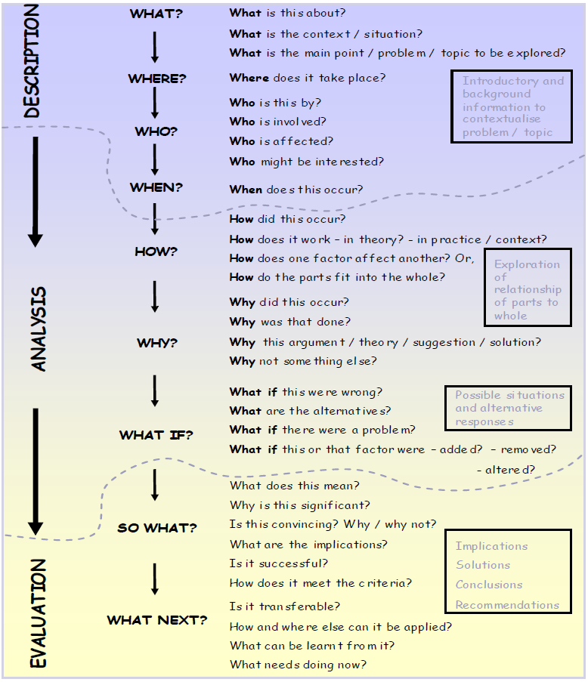
Model for Critical Thinking & Writing
You can use this framework to develop your position on any topic – and it’s a really good model for writing too.
Good arguments present reasons and evidence in a structured way, so that information builds on what has already been said.” (Cottrell, 2017, p.xiv)
At Level 6, most of your writing should be discussing questions from ‘How?’ downwards. Description should be kept to a minimum.
Full document is here (click link to access).
University of Plymouth (2010)
Notes:
As learning to read, think and write critically can be challenging when you start to apply it to a new subject, it’s useful to have a model or framework that you can use to develop these skills. There are lots of good textbooks and websites about critical thinking on the reading lists and it really is important that you do take the time to find and read them – maybe even buy one to support you through the next two years as there’s a lot more to this aspect of your work than I can present in two sessions. However, this particular model is, in my view, the best and most straightforward simplification of the main principles that I’ve found – and I’ve been using this one for several years now. It presents a coherent and well-structured ‘line of reasoning’ that you can follow to develop a critical discussion – bearing in mind that good communication presents information in a structured way so that new information builds on what has already been said. It’s pretty much a direct expansion of the PEEL framework that we looked at for Level 4 – but at this level, it acknowledges the real complexity of the ‘Explain’ section and shows you how to develop your skills of evaluation and analysis as well as your explanation. The idea is that when constructing an essay topic, you select some questions from each section to answer – in this order from description, through analysis and ending with conclusions - within your discussion. You can’t select them all – you won’t have the word count – but you can use them to develop a more critical discussion that analyses your topic a little more fully.
For example – main body topic might cover:
What is this about?
Where does it take place?
Who is affected?
How does this work in theory or in practice? Are there differences?
Why did this happen?
What are the alternatives?
What does this mean?
Why is it significant?
Where else can this be applied?
What have I learned?
What do I need to do now?
With Level 6 work, you won’t find all of the answers to these questions as they relate to your assignment topic on your reading lists – critical thinking really does mean thinking for yourself – so this framework acts as a prompt to make sure that you’ve thought your discussion through and developed it properly. While you’ll need to work with the descriptive questions at the top of the framework to introduce your topic, in general, for Level 6 writing, the more words you can spend on the questions towards the bottom, the more marks you’re likely to get. The framework is part of a fuller document about Critical Thinking from the University of Plymouth and I strongly recommend that you read the entire thing,

Slide 12
What questions do you have?

Slide 13
Reference List
Cottrell, S. (2017) Critical Thinking Skills: Effective Analysis, Argument and Reflection (3rd edn.) London: Palgrave
Ennis, R.H. (2011) The Nature of Critical Thinking: An Outline of Critical Thinking Dispositions and Abilities Available at: https://education.illinois.edu/docs/default-source/faculty-documents/robert-ennis/thenatureofcriticalthinking_51711_000.pdf [Accessed: 7 September 2021]
Moon, J. (2007) Critical Thinking: An Exploration of Theory and Practice Abingdon: Routledge
Nursing and Midwifery Council (2018) The Code: Professional standards of practice and behaviour for nurses, midwives and nursing associates Available at: https://www.nmc.org.uk/standards/code/ [Accessed: 11 March 2021]
Price, B. and Harrington, A. (2016) Critical Thinking and Writing for Nursing Students (3rd edn.) London: Sage
Quality Assurance Agency (2014) UK Quality Code for Higher Education. Part A: Setting and Maintaining Academic Standards. The Frameworks for Higher Education Qualifications of UK Degree-Awarding Bodies
University of Plymouth (2010) Critical Thinking Available at: https://www.plymouth.ac.uk/uploads/production/document/path/1/1710/Critical_Thinking.pdf [Accessed: 23 August 2021]
Van Gelder, T. (2005) ‘Teaching Critical Thinking: Some Lessons from Cognitive Science’ College Teaching 53(1): 41-46
Weir, K. (2017) Why we believe alternative facts: how motivation, identity and ideology combine to undermine human judgement Available at: https://www.apa.org/monitor/2017/05/alternative-facts [Accessed: 2 September, 2021]

